Slide 1
Application of the ground water irrigation system using solar power generation as a Water-Energy-Food-Nexus model project
Digital Agriculture Workshop
BONGKYUN, KIM
Korea Rural Community Corporation
Notes:
Good morning,
My name is BONGKYUN KIM from KRC (korea rural community corporation)
and I am Working for Overseas project office.
It is a great honor to deliver my presentation here today.
My presentation is about Application of the Groundwater Irrigation System using Solar Power Generation as a Water-Energy-Food-Nexus Model Project

Slide 2
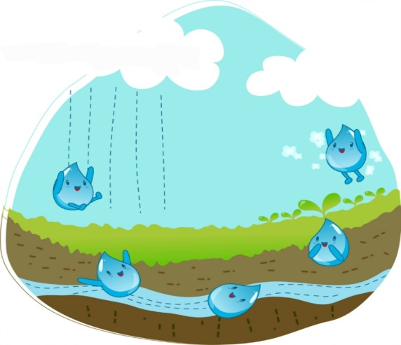
Contents
1
Background
2
Status of El Salvador and Project Area
3
Project Concept and Analysis
4
Project implementation
5
Conclusion and Suggestions
Digital Agriculture Workshop
Notes:
The order of presentation is Background, Status of El Salvador and Project Area, Project Concept and Analysis, Project implementation, Conclusion and Suggestions.

Slide 3
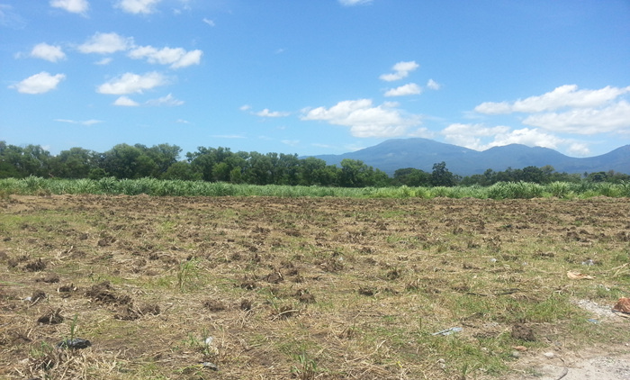
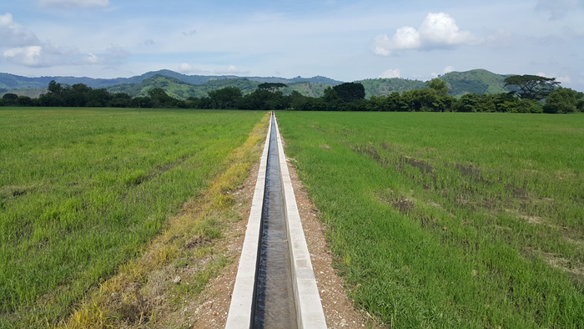
1. Background
Challenges and Solution
Challenges | Many developing countries have tried to grow economy and reduce poverty in rural area. ⇒ It is necessary to install efficient irrigation system to secure stable water supply. High operation cost for irrigation is main cause of unsustainability.
Solution | As a Proposed Project, ⇒ "Application of the ground water irrigation system using solar power generation as a Water-Energy-Food-Nexus model project" in El Salvador
Digital Agriculture Workshop
Notes:
As Many developing countries have tried to grow economy and reduce poverty in rural area.
⇒ It is necessary to install efficient irrigation system to secure stable water supply.
but, High operation cost for irrigation is main cause of unsustainability.
In order to solve such problem, We Proposed this project, "Application of the ground water irrigation system using solar power generation as a Water-Energy-Food-Nexus model project" in El Salvador

Slide 4
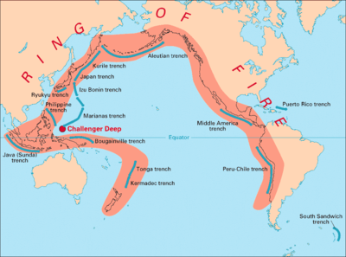
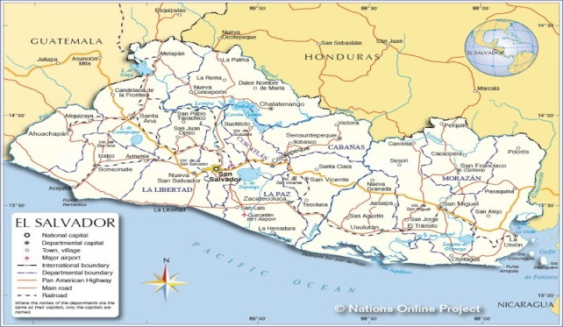
2. Status of El Salvador and Project Area
El Salvador
Area 2.1 M ha (along the Pacific Ring of Fire) Annual economic growth : 1.9% Annual precipitation : 1,850mm/year Total renewable water resources : 17.8㎦/year Surface water : 11.6㎦/year (wet 84%, dry 16%) Groundwater recharge : 6.15㎦/year(avail 5.97㎦/year) Irrigated area : 200,000 ha (56% surface, 44% ground) Cultivation : coffee & sugar Power generation : 1,503 MW National electric supply : 92.6%
Project Area
Single cropping : on wet season only (May ~ Oct)due to shortage of water and energy. volcanic soil : insufficient water, only ground water in dry season. Target crops : rice & vegetable
Digital Agriculture Workshop
Notes:
Status of El Salvador and Project Area
El Salvador is the smallest and most densely populated country in Central America.
It has 2.1 M ha of territory, which shares borders with Guatemala and Honduras.
Annual economic growth rate is 1.9% and annual precipitation is 1,850mms per year.
The total renewable water resources is estimated at 17.8㎦, of which 11.6㎦ are surface water. The 84 percent of this runoff occurs during wet season and 16 percent during the dry season.
Annual groundwater recharge is around 6.15㎦ and the Potential availability is 5.97㎦// Irrigated area is about 200,000ha and Power generation capacity is 1,503MW and National electric supply rate is 92.6%
El Salvador is located along the Pacific Ring of Fire. So, There are many frequent earthquakes and volcanic activities.
Single cropping is only carried out during the wet season due to the shortage of water and energy.
since the project area consists of volcanic soil, surface water is insufficient for farming.
therefore, this project should provide the solution to farmers to use groundwater in dry season.
rice & vegetables are Main crops of the project area

Slide 5
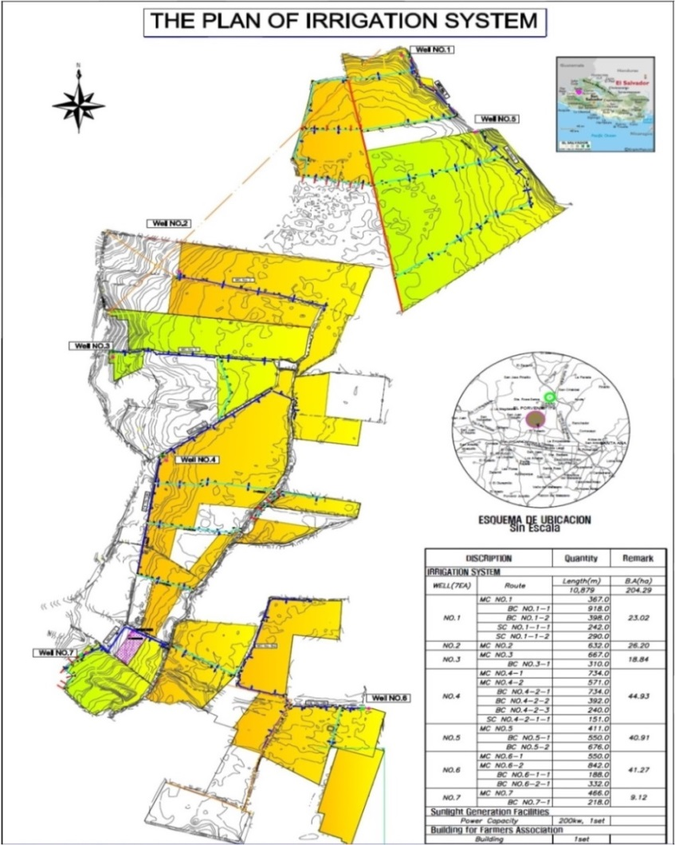
3. Project Concept and Analysis
Project outline
Benefit Area | 204ha
Total Cost | $ 5.7 million(KOICA $ 4.7, El Salvador $ 1.0)
Duration | 2013 – 2017 (5 Years)
Main facilities | 250 kW solar power plant 7 Wells(depth 100m) (Q=3.4㎥/min) 10.88 km Canals Farmers' Union Building and Multi-purpose Warehouse Electric facilities
National Grid
Well # | Sum | Well 1 | Well 2 | Well 3 | Well 4 | Well 5 | Well 6 | Well 7
B A (ha) | 204.29 | 23.02 | 26.20 | 18.84 | 44.93 | 40.91 | 41.27 | 9.12
Digital Agriculture Workshop
Notes:
I worked for two years as a project manager for this project.
I'll introduce the project outline for your quick understanding.
Benefit Area is 204ha.
The total cost is $ 5.7 million, of which Koica paid $ 4.7 million and the government paid $ 1 million.
The main facilities are a 250 kWh solar power plant and 7 wells with a capacity of 3.4 square meters/min per each well and 11km of irrigation canals, Farmers' Union Building and multipurpose warehouse and electrical facilities.

Slide 6
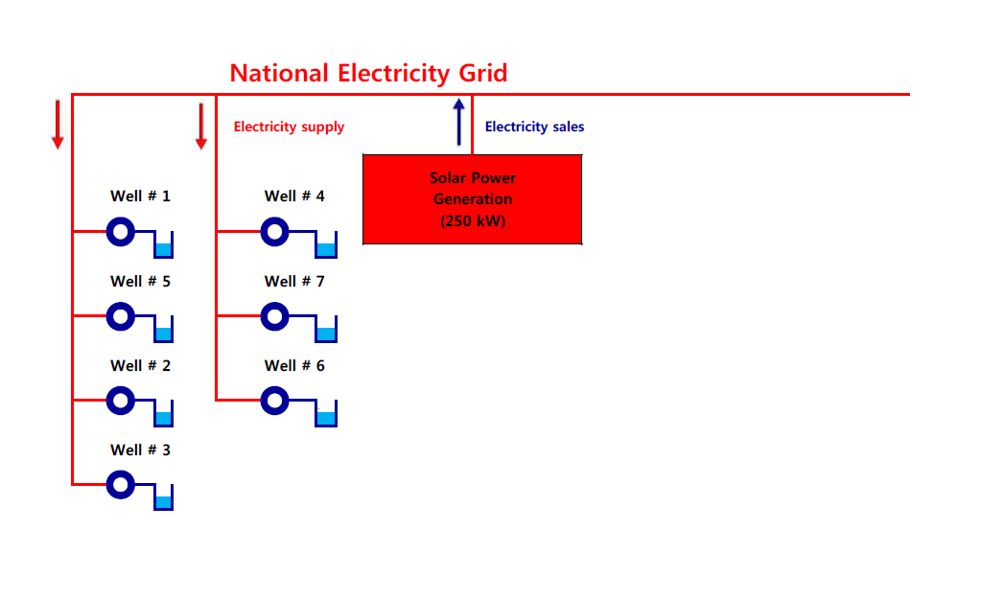
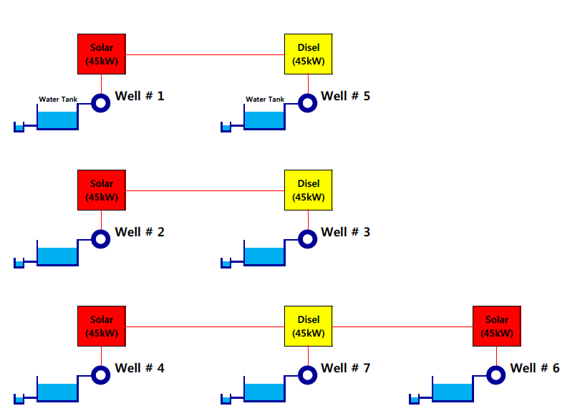
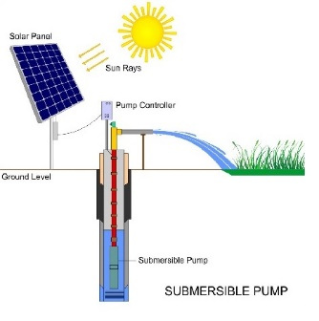
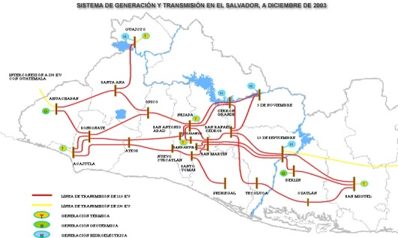
3. Project Concept and Analysis
Project Concept
Concept 1 : Individual solar power system - 4 Solar(45 kW)+ 3 Diesel generators+ 7 Water tanks | Concept 2 : Connected to National Grid -1 Solar (250kW) to be sold to National Grid
Digital Agriculture Workshop
Notes:
When we planned this project,
We had to decide whether to connect the solar power generators to the national power grid or install them individually.
Concept 1 consisted of four solar generators and three diesel generators and each well has a large water tank.
On Concept 1, we need to install 3 diesel generators and 7 water tanks for irrigation on cloudy days.
Concept 2 is a concentrated solar power plant and 7 wells are connected to the national power grid.
On Concept 2, All solar generators could be installed in one place and the power generation could be sold to the national power grid.
and the generated power (which is 250 kWh, less than 5 hours a day) can cover the operating cost of 7 water pumps.
All wells are connected to the national power grid, so we can use electricity at any time.

Slide 7
3. Project Concept and Analysis
Project Concept Analysis
Concept 1 : Individual power system | Concept 2 : Connected to National Grid
Contents | Cost ($) | Remarks
1.Development cost | 2,706,500
Solar systems | 366,300 | 4sets*45kW
Diesel generator | 79,600 | 3sets*45kW
Water tanks | 185,800 | 7EA
Land for Water tanks | 123,800 | 7*400m2
Well+Electricity+Canal | 1,951,000 | 7wells, Electric 3km+canal 11km
2.O&M cost | 56,400 | Annual
Inspection | 2,800 | 4times/Year
Repair | 10,600 | 4times/Year
Diesel | 43,000 | 3Generators
Contents | Cost ($) | Remarks
1.Development cost | 2,459,000
Solar system | 508,000 | 250kw
Well+Electricity+Canal | 1,951,000 | 7wells,Electric 3km+canal 11km
2.O&M cost | 13,400 | Annual
Inspection | 2,800 | 4times/Year
Repair | 10,600 | 4times/Year
O&M cost : 1%
O&M cost : 2%
Development cost : 99%
Development cost : 98%
90%
23%
1. Development cost
2. O&M cost
Notes:
- We calculated the cost of Concept 1(the original plan) and Concept 2
- Development cost of Concept 1 is $ 2.7million and O&M cost is $56,400
- Development cost of Concept 2 is $ 2.4million and O&M cost is $13,400
- Development cost of Concept 2 is 90% of Concept 1
- and O&M cost of Concept 2 is 23% of Concept 1.
- After cost analysis of Concept 1, we can find development cost is majorly occupied with water tanks and land acquisition.
and diesel for generation.
- Concept 2 was chosen by considering cost analysis like this.

Slide 8
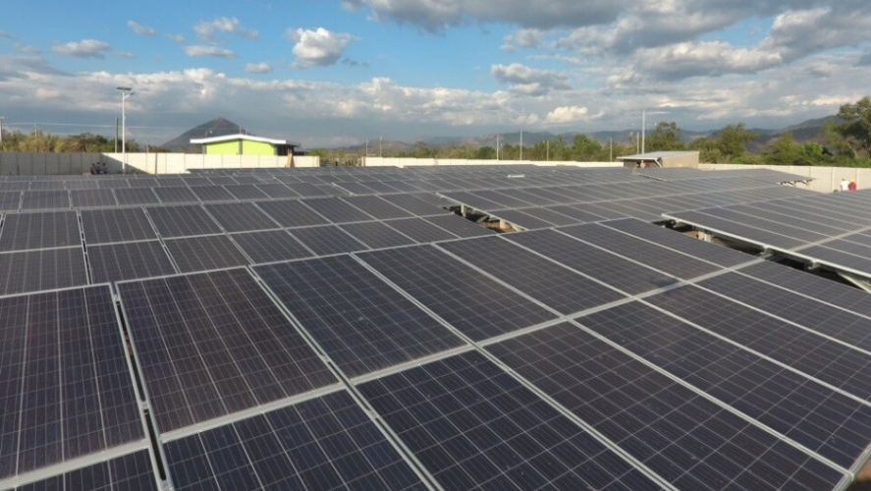
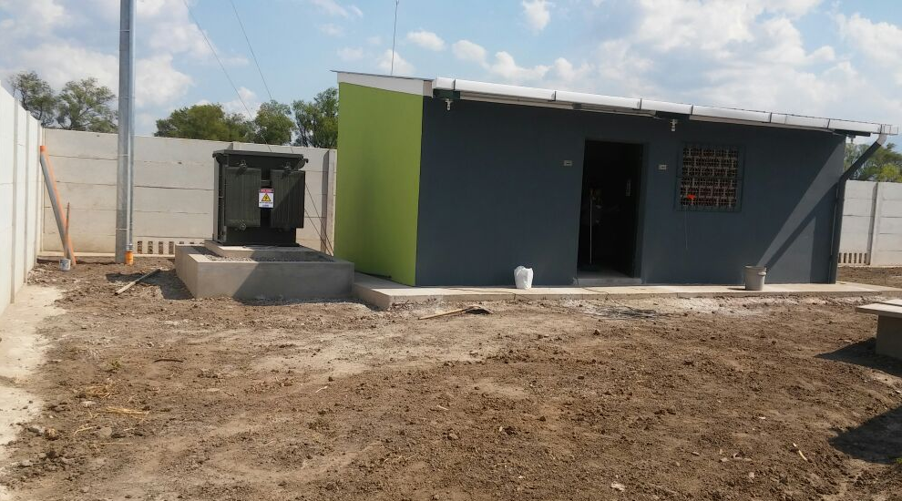
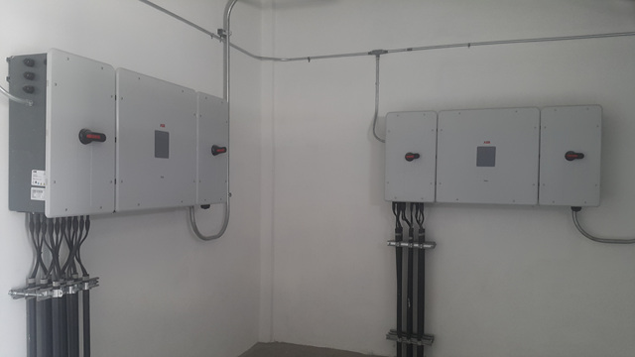
4. Project implementation
SOLAR PANELS (798 MOULES)
No. 4-2-1 Irrigational canal (0.35m x 0.35m)
TRANSFORMER : 0.4 / 13.2 [kV]
INVERTERS : 50[kW] 5 UNITS
250 [kW] SOLAR POWER GENERATION FACILITY
Digital Agriculture Workshop
Notes:
these are the picture of SOLAR PANELS, transformer and inverters and irrigational canal.

Slide 9
4. Project implementation
Comparison of Production
Because of sufficient irrigational water supply in dry season, production can be increased by 152% and farmer's income by 195%
Agricultural products | Before |  |  | After |  |  | Difference
 | Area (ha) | Production (ton) | Income ($) | Area (ha) | Production (ton) | Income ($) | Area (ha) | Production (ton) | % | Income ($) | %
Total | 204 | 2,550 | 1,868,396 | 204 | 3,870 | 3,651,704 | 0 | 1,320 | 152 | 1,783,308 | 195
Rice | 142 | 248 | 210,552 | 157 | 408 | 346,392 | 15 | 160 | 165 | 135,840 | 165
Watermelon | 50 | 2117 | 1,473,432 | 30 | 1905 | 1,325,880 | -20 | -212 | 90 | -147,552 | 90
Maize | 10 | 48 | 8,688 | 2 | 14 | 2,534 | -8 | -34 | 29 | -6,154 | 29
Tomato | 1 | 68 | 85,748 | 8 | 818 | 1,031,498 | 7 | 750 | 1,203 | 945,750 | 1,203
Cucumber | 1 | 69 | 89,976 | 7 | 725 | 945,400 | 6 | 656 | 1,051 | 855,424 | 1,051
※Unit prices of products are applied based on present market price
AREA
PRODUCTION
INCOME
Digital Agriculture Workshop
Notes:
Also, We compared the production before and after of this project.
Because we are able to provide sufficient irrigational water in dry season,
production and farmer's income can be increased by 152% and 195% respectively.

Slide 10
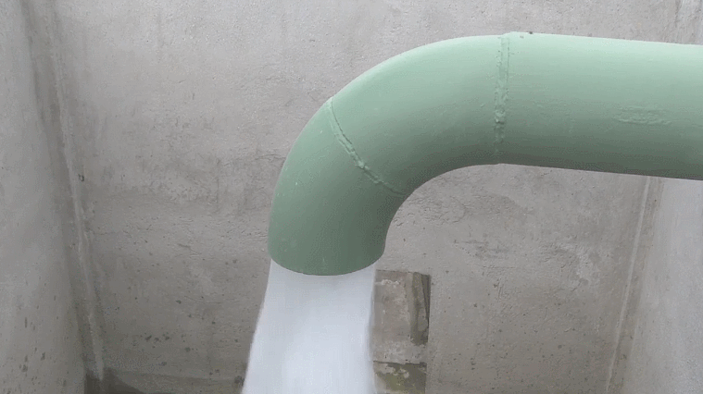
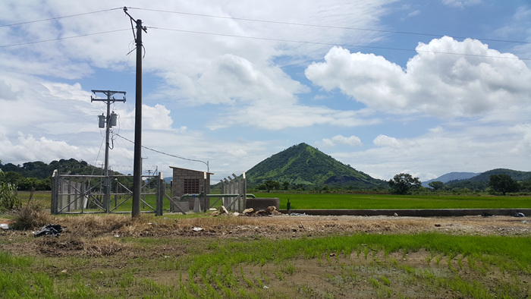
4. Project implementation
Economic analysis
B / C Ratio (30 years operating, 12% discount rate applied) - Concept 1 : 1.23, Concept 2 : 1.57
Concept 2 | Cost($) |  |  | Increased production ($) | Remarks
 | Total | Development | O & M
Year 1 | 259,285 | 245,985 | 13,400 | 365,170 | First Year
Year 30 | 2,861,000 | 2,459,000 | 402,000 | 10,955,112 | Operating for 30 years
 | Present Value of Cost : $1,871,865 |  |  | Present Value of Benefit: $2,941,515 | B/C = 1.57, NPV = $1,069,649
Well#6 (Depth=100m, Q=3.4㎥/min)
Well #2 connected with the national grid
Digital Agriculture Workshop
Notes:
- B / C ratio of Concept 1 is calculated as 1.23 with condition of 30 years operating and 12% discount rate.
- B / C ratio of Concept 2 is calculated as 1.57
At the first year, total cost is $ 0.2 million and benefit is $ 0.3 million.
After 30 years operation, total cost is $ 2.8 million and benefit is $ 10.9 million.

Slide 11
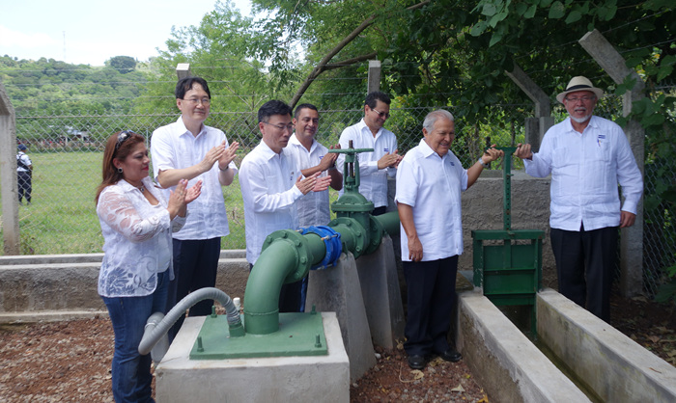
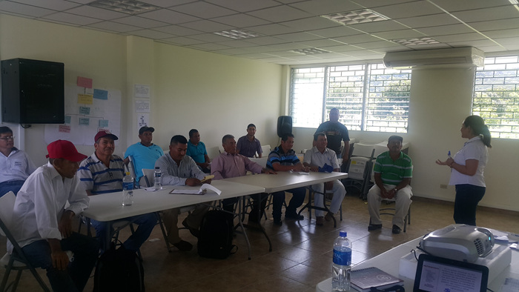
5. Conclusion and Suggestions
Conclusion and Suggestions
"Ground water irrigation system combined with solar power linked to the national grid Concept" can reduce O & M cost and improve agricultural production and productivity in El Salvador. In order to increase agricultural production in developing countries, it is important to choose an efficient energy source for irrigation that matches the characteristics of the country and region.
Well Gate Opening Ceremony with VIP
Farmers' Union Education
Digital Agriculture Workshop
Notes:
"Ground water irrigation system combined with solar power linked to the national grid Concept" can reduce O & M cost and improve agricultural production and productivity in El Salvador.
In order to increase agricultural production in developing countries,
It is very important to select the appropriate energy source for irrigation that matches the characteristics of the country and region.

Slide 12
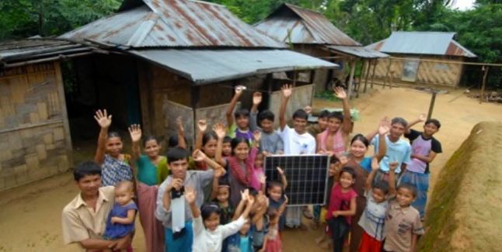
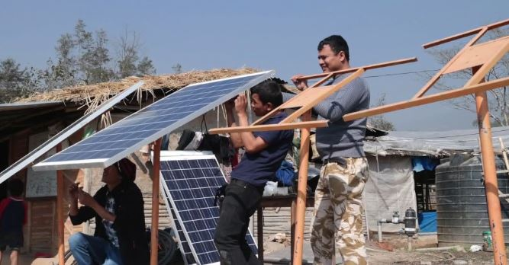
5. Conclusion and Suggestions
Application of Solar Energy to the ODA Project
El Salvador's case showed that solar power project could contribute to improving agricultural production. When ODA project is carried out in the future, solar power generation projects are needed for energy efficiency and clean energy production. To do so, continuous research and information sharing of the solar power systems should be maid to enhance agricultural productivity and energy independence.
Digital Agriculture Workshop
Notes:
El Salvador's case showed that solar power generation project could contribute to improving agricultural production. When ODA project is carried out in the future, solar power generation projects are needed for energy efficiency and clean energy production.
To do so, continuous research and information sharing of the solar power systems should be maid to enhance agricultural productivity and energy independence.

Slide 13
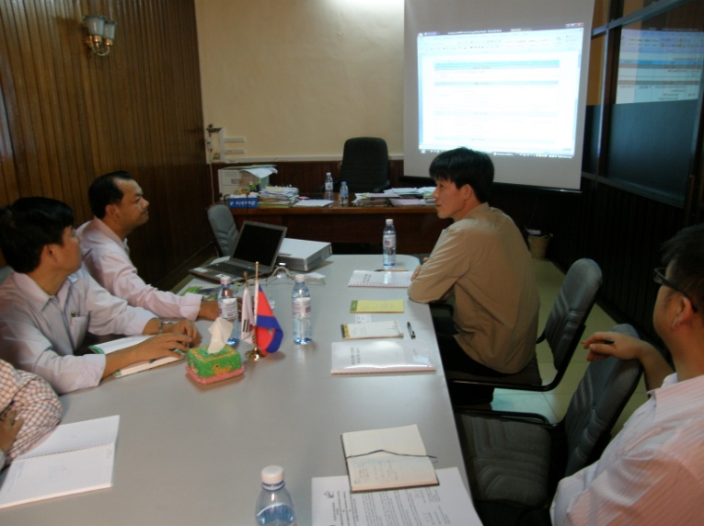
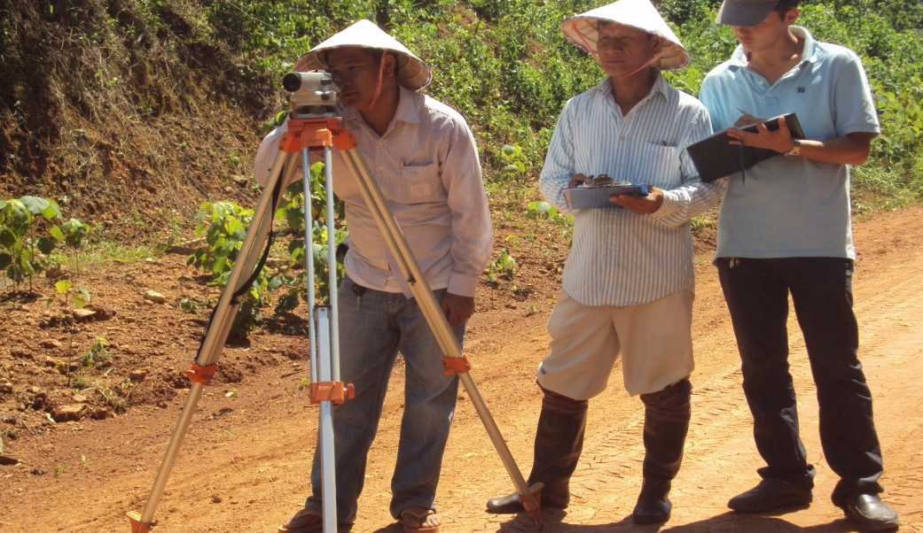
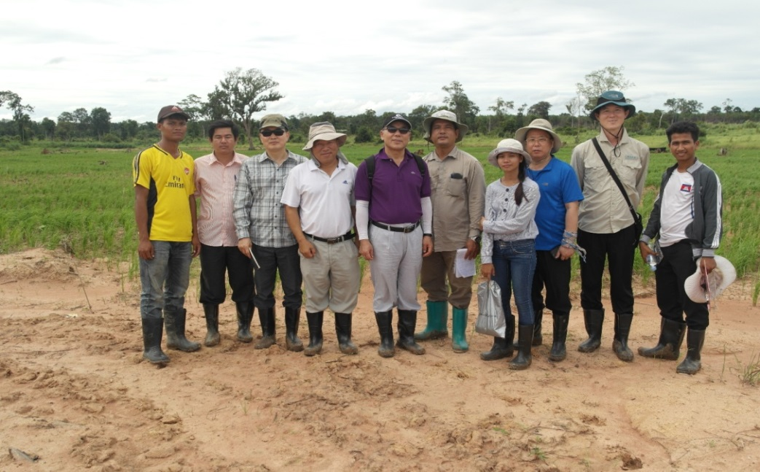
5. Conclusion and Suggestions
Role of KRC
Pre-demand consultations with departments in charge of solar energy project and Ministry of Food and Rural Affairs. Select a sample project to maximize energy efficiency and increase agricultural productivity through field survey.
Feasibility Study
Field Survey
Digital Agriculture Workshop
Notes:
It is going to carry out Pre-demand consultations with departments in charge of solar energy project and Ministry of Food and Rural Affairs.
We will select a sample project to maximize energy efficiency and increase agricultural productivity through field survey.

Slide 14
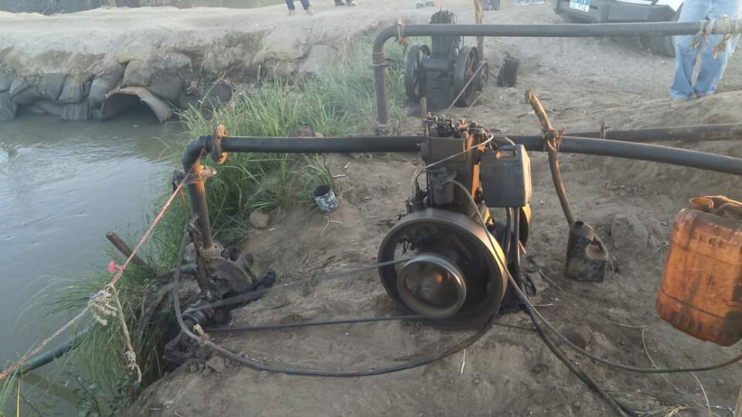
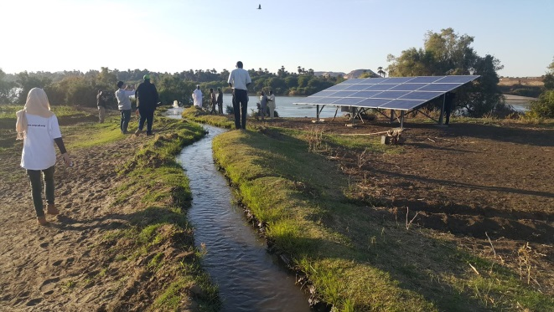
5. Conclusion and Suggestions
Solar energy project in Sudan
Project Title: Solar water pumps for Sustainable Agriculture in Sudan Location : River Nile State, Sudan, Duration : 2019 ~ 2023(48 months) Objective : to enhance sustainable agriculture in Sudan by promoting the use of solar water pumps instead of diesel-based waters pumps Implementing organization: Ministry of Water Resources, Irrigation and Electricity Budget : KOICA funding US$ 6,400,000 (UNDP: US$ 5,570,000, KOICA: US$ 830,000) - UNDP : installing of 450 pumps (250 × 3.12 kW, 200 × 5.12 kW) , Establishing of 45 demonstration plots, , funding for the National PV fund, training for farmers - KOICA : project monitoring including 2 invitational trainings
Digital Agriculture Workshop
Notes:
I will introduce new solar energy project in Sudan
I visited Sudan twice in 2018 and 2019 and I participated in the basic surveys as a civil engineer to investigate project proposal.
Project Title is "Solar water pumps for Sustainable Agriculture in Sudan
Location is River Nile State in Sudan
Duration is from 2019 to 2023(48 months)
Objective is to enhance sustainable agriculture in Sudan by promoting the use of solar water pumps instead of diesel-based waters pumps
Implementing organization is Ministry of Water Resources, Irrigation and Electricity
Budget consist of KOICA funding US$ 6,400,000 (UNDP: US$ 5,570,000, KOICA: US$ 830,000)
- UNDP will install 450 pumps (250 × 3.12 kW and 200 × 5.12 kW), Establish 45 demonstration plots, and train farmers, will make funding for the National PV(Photovoltaic) fund.
- KOICA will do project monitoring including 2 invitational trainings.

Slide 15
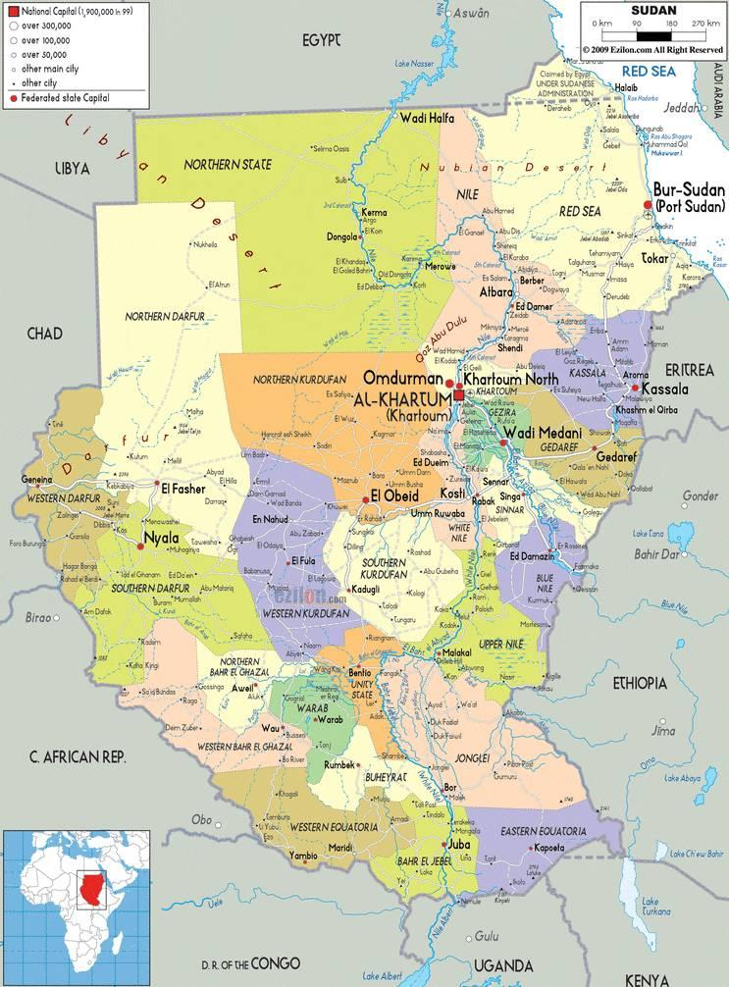
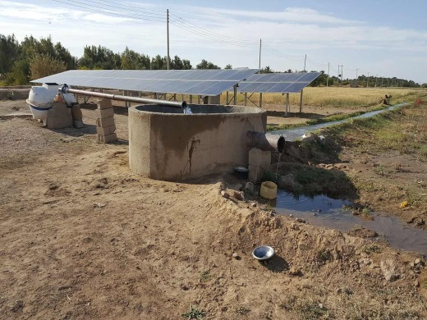
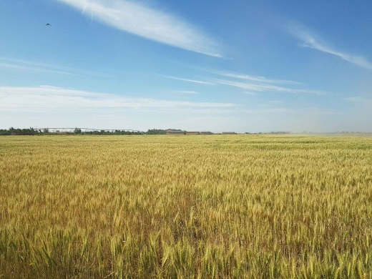
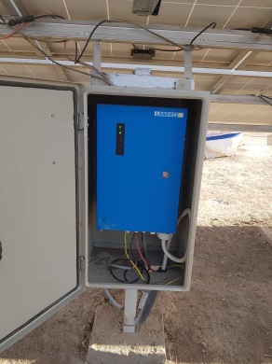
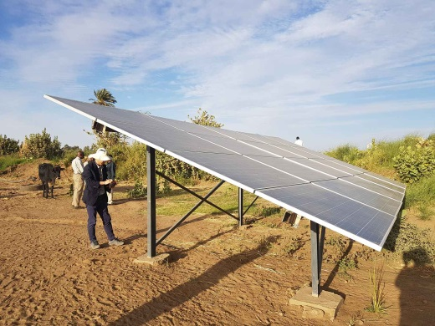
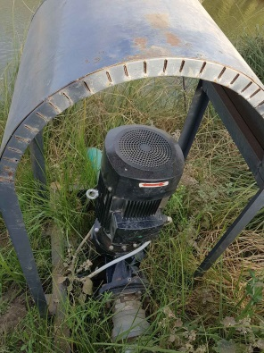
5. Conclusion and Suggestions
Ground water Pump Depth : 27m, Q : 70㎥/hr, A : 10ha , Budget : 30,000US$, 19.76kW, Pannels : 260Wp×76(China), Controller : LORENTZ
River Pump height: 3m , Q : 20㎥/hr, A : 3ha , Budget : 8,000US$,
V= 5.6KW, Pannels : 260Wp×20(China), Controller : LORENTZ
River Nile State, Sudan
Digital Agriculture Workshop
Notes:
This is Ground water pumping station powered by solar energy in the northern state.
Ground water Depth is 27m, Quantity is 70㎥/hr, beneficial Area is 10ha , Budget is 30,000US$,
V= 19.76kW, Pannels : 260Wp×76(china), Controller : LORENTZ
This is river water pumping station powered by solar energy.
height: 3m , Q : 20㎥/hr, A : 3ha , Budget : 8,000US$,
V= 5.6KW, Pannels : 260Wp×20(china), Controller : LORENTZ
On the basic survey I was able to understand the needs and efficiency of solar water pump.
On the last survey I met a farmer who installed solar water pump instead of his old diesel pump.
After installing the solar pump, he saved diesel prices and repair costs, and he liked that free time was more than before because he did not have to keep watching the pump.
The farmer earned twice as much as last year's $ 40,000 agricultural income with sufficient water supply.
Last year, he bought four new cows for his increased income.

Slide 16
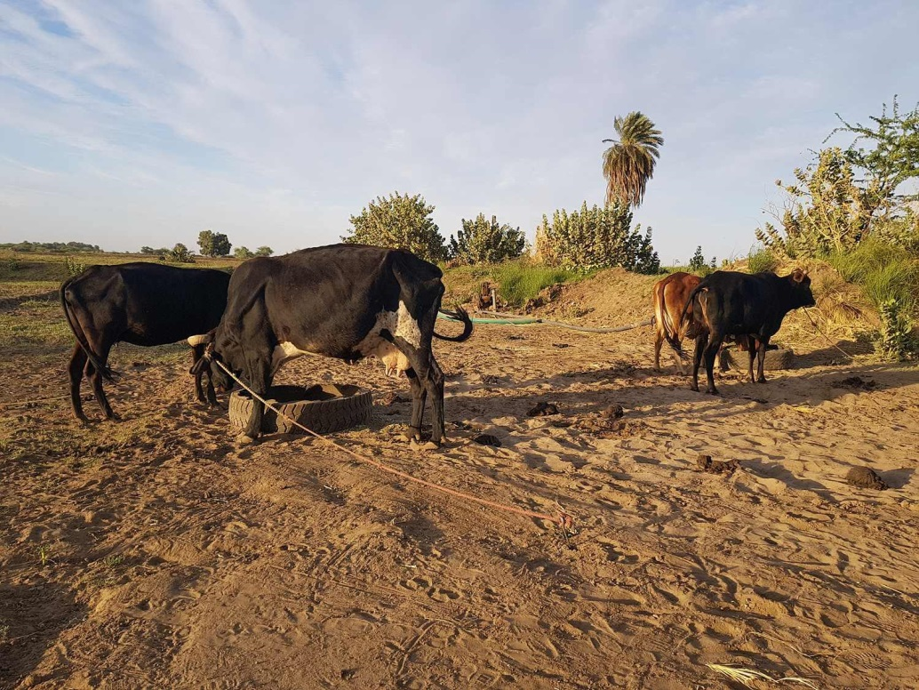
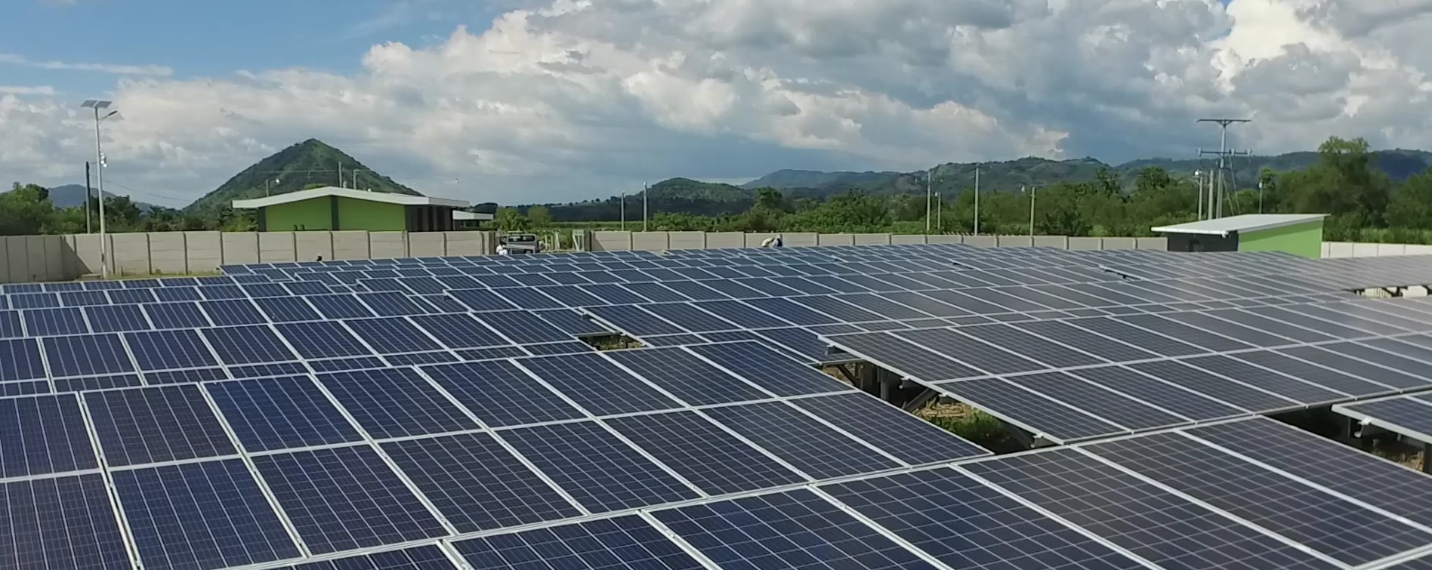
Thank you for your attention
(KIM BONGKYUN / E-mail : bongdol@ekr.or.kr)
Digital Agriculture Workshop
Notes:
and This is the picture of his 4 new cows.
he hopes to build a new home and live a happy life in the future with a wider land.
Thank you for your attention

